Slide 1


BANK BOT SYSTEM at
UNITED COLLEGE OF ENGINEERING & RESEARCH
ANUPAM SHUKLA 2000100100036
VIVEK VESHWAKARMA 2000100100194

Slide 2

Topics Covered
In Bullets

Slide 3
Introduction
INTRODUCTION
In this project, the Bank management System Python Project using Tkinter, the user can create an account by entering information such as his or her username, opening balance, and pin number. The user must then submit those data in order to gain access to their account. The user can see transaction information, balance inquiries, credit and debit amounts, and more. The user can credit or debit sums by merely specifying a specific amount.

Slide 4
Methodology
﻿
Bank Management System Project in Python is a
straightforward GUI-based program that is simple to grasp and utilize. The GUI is created with the Tkinter package. When it comes to the application, users may easily register an account and log in to manage their bank accounts.

Slide 5
Results / Snapshots
FEAUTURES
Bank Management System Project in Python, let us take a look at the features our UI will have:
Login/Create a bank account
Credit and debit amount
Balance inquiry
View transaction logs

Slide 6
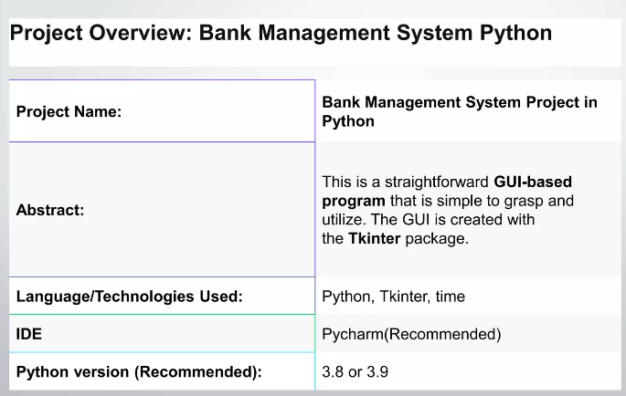

Slide 7
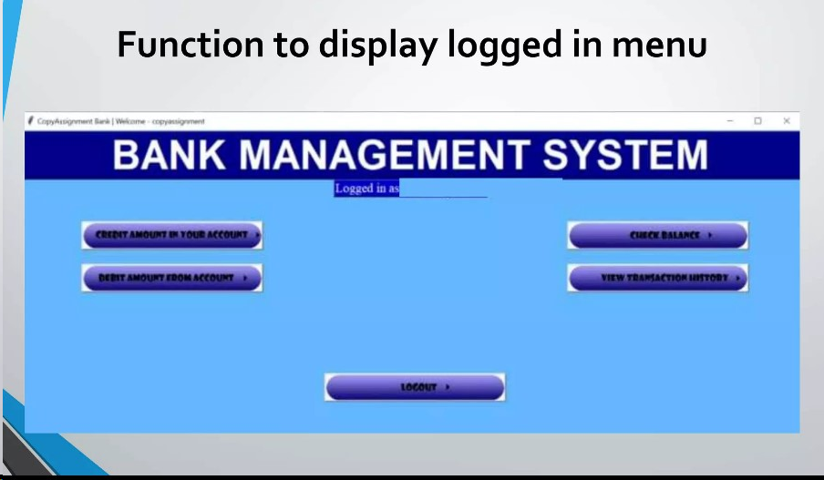
Future Scope

Slide 8
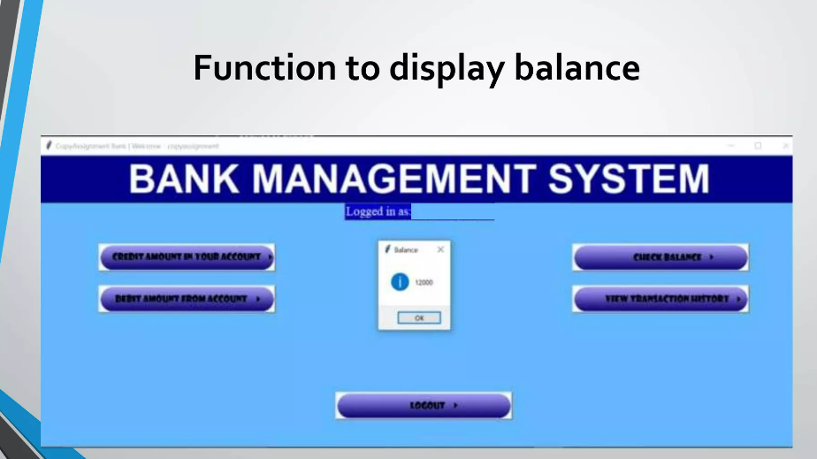

Slide 9
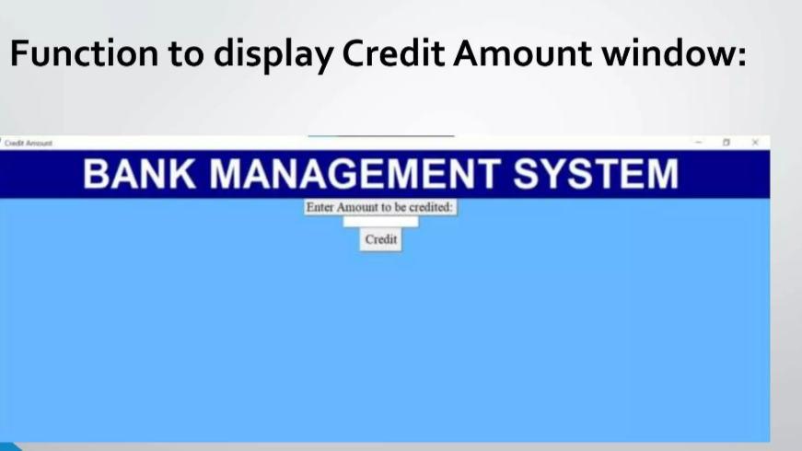

Slide 10
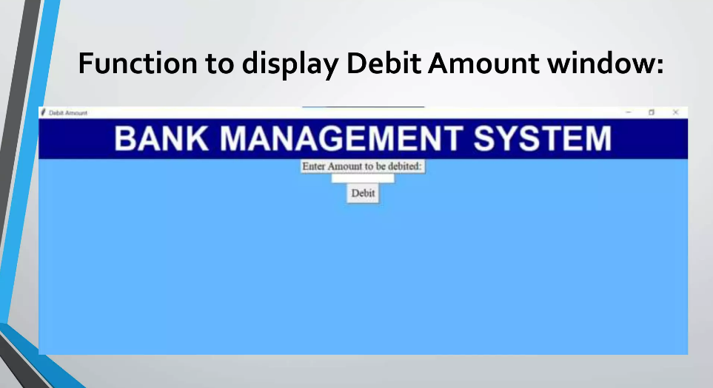

Slide 11
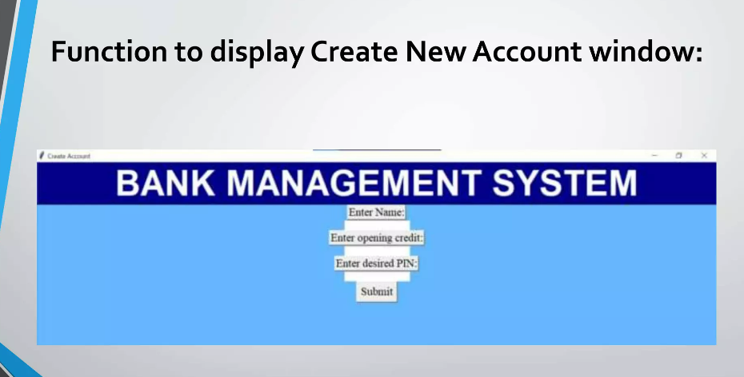

Slide 12
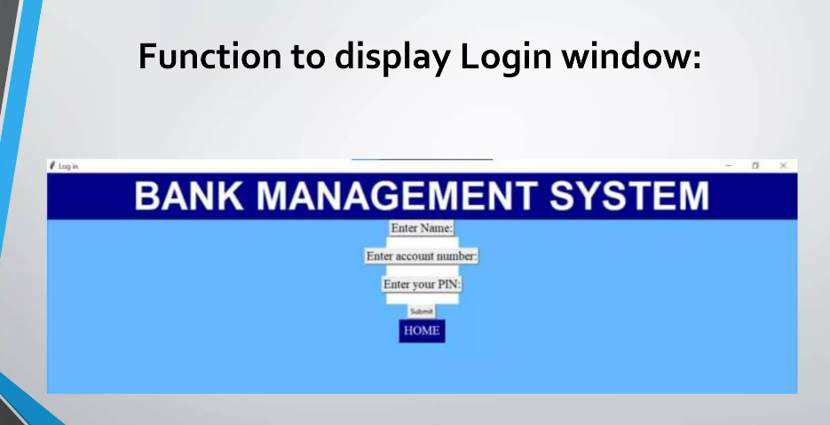

Slide 13


